Slide 1
QLC CaseStudy
Sushant karande

Slide 2
Agenda
Data Cleaning
Data preprocessing
Exploratory DataAnalysis
Visualizations
Insights

Slide 3
Details about Dataset
We have given Opportunity Id, implies if we are selling any product to one company for that we create opportunity. So, whatever discussion happens with our customer our sales person adds it in to the CRM.
Now your goal is to collect all the descriptions happening at opportunity level. Use that description to predict whether we will win the case or not.
There are 215636 rows and 4 columns in a dataset.

Slide 4
Missing values
There are 128 null values in ActivityDescription column.
If we have a look on the dataset there are 215636 rows which are more in number and 128 null values.
So dropping 128 values wont effect much on the dataset analysis.
So we dropped null values.

Slide 5
Data Preprocessing
So after dealing with missing values,we had to do some data cleaning and preprocessing.
Steps performed for text processing:
Converted Text in Lowercase
Removing Special Characters
Removing links
Removing Numbers

Slide 6
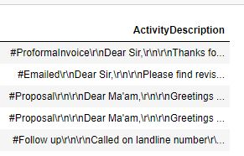
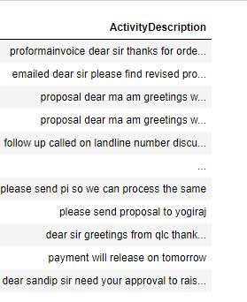
Text before Cleaning
Text After Cleaning

Slide 7
Further steps Performed:-
Tokenization of Data.
Removal of Stopwords.
Stemming and Lemmatization.
Converting data back to string.

Slide 8
Feature Engineering
After performing some preprocessing on data next step I had perpormed is Feature Engineering.
In OpportunityStageName Column there are various stages of Opportunity labelled.
So I had created a new column named as Label.
In this step,I had classified stages in to Positve,Negative and Neutral

Slide 9
Opportunity stages such as ‘Closed Dead','Closed Lost','Overdue comes under Negative Label.
Opportunity stages such as 'Closed Won','Closed Happy Free','Negotiating','Reversal','Demonstration','Lead Qualification‘ comes under Positive Label.
Opportunity stages such as ‘Need Analysis’,Prospecting ,Proposal’ comes under Neutral Label.

Slide 10
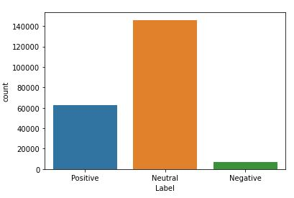
Countplot of new created Category

Slide 11
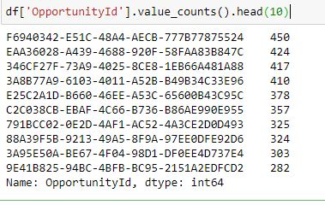
EDA and Visualizations
The first column where OpportunityID is generated after the purchase here are some analysis.
These are the top 10 IDS which are more active in these process.Their count in given below.

Slide 12
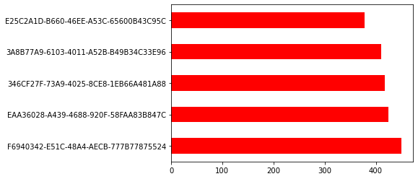
Count of Top 10 OpportunityID which more active.

Slide 13
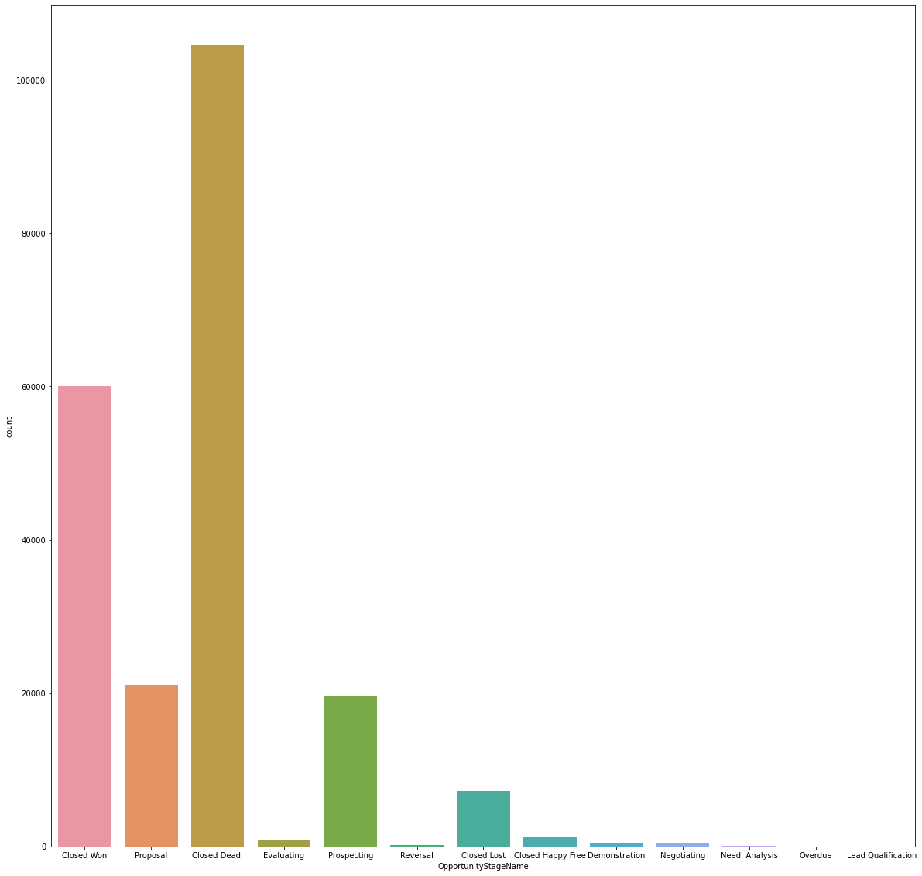
Countplot of Opportunity Stages

Slide 14
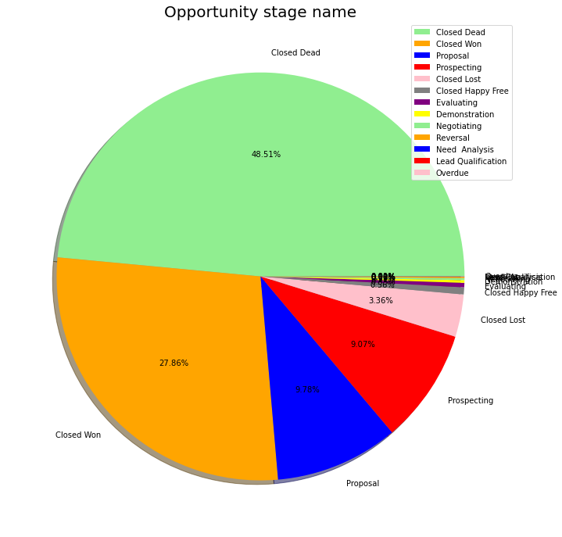
Pie chart representing the Percentage of Opportunity Stage name.
Highest percent are of Closed Dead with 48.51%,Second is Closed Won with 27.86%.and so on.

Slide 15
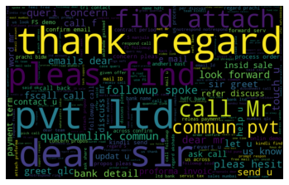
These is a WordCloud representing the highest Count of a Specific word in ActivityDescription Column.

Slide 16
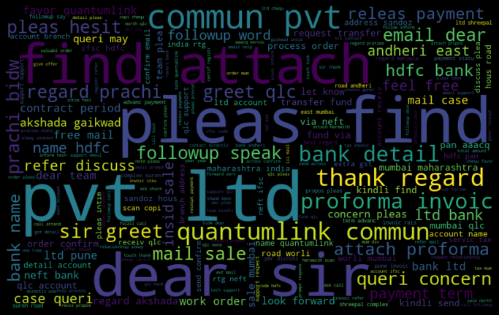
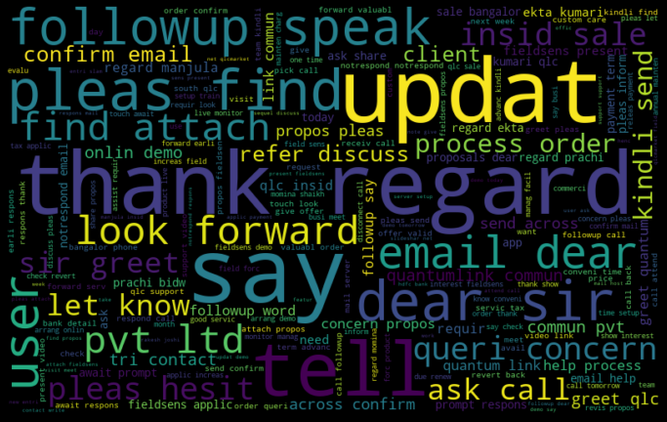
WordCLoud For Closed Won Category
WordCloud For Closed lost Category

Slide 17
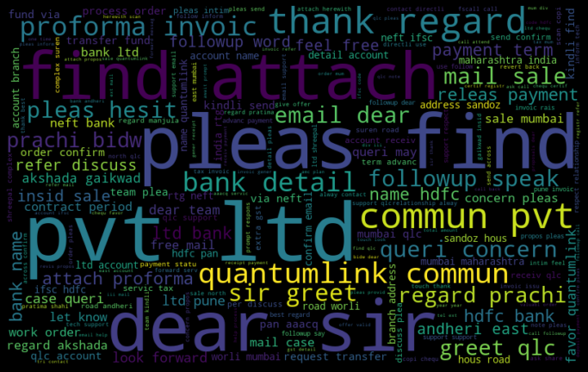
We had classify the data of Opportunity Stages in to Positive,Nagative and Neutral during Feature Engineering.
So this is the word cloud of Positive stages.

Slide 18
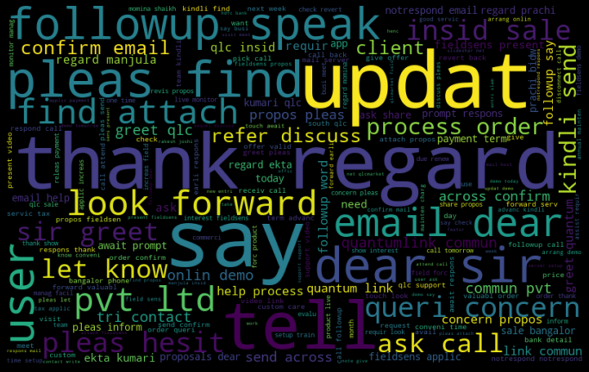
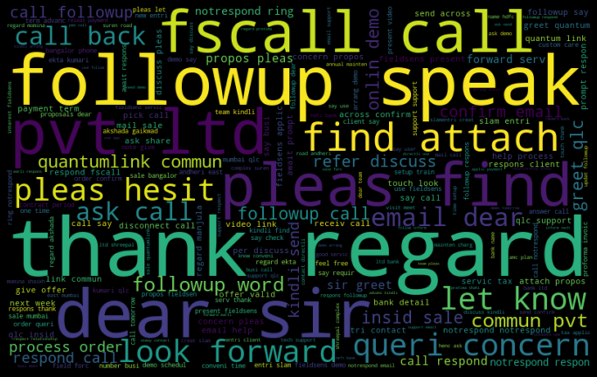
Negative stages Wordcloud
Neutral stages Wordcloud

Slide 19
Model building
Data set is splited using train-test split method from sklearn.
Random forest Classifier is used for model building.
Note:-Some minor error is showing during model building but rest of the part is done.

Slide 20
Some Insights
After doing all the analysis,Since I had classifiy the data of different opportunity stages in to Positve,Negative and Neutral.
We need to work on the IDs which comes in all these categories.
IDs coming in Positive and Neutral category are seem to be loyal customers and we should try to give them good services.
IDs coming under Negative category we should give them some offers in the sales for good business.

Slide 21
THANK YOU

